Slide 1
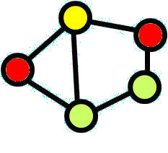
Lecture 16-20: Queues and Markov Chains
Giovanni Giambene
Queuing Theory and Telecommunications: Networks and Applications
2nd edition, Springer
All rights reserved

Slide 2
Introduction to Queuing Systems

Slide 3
Background
What happens to file retrieval time when disk I/O utilization goes up?
Does response time change if both processor speed and the number of users on the system are doubled?
How many lines should a time-sharing system have on a dial-in rotary?
How many terminals are needed in an online inquiry center, and how much idle time will the operators have?
The number of questions that can be addressed with a queuing network(/analysis)is endless
and touches on virtually every area in computer science.
.

Slide 4
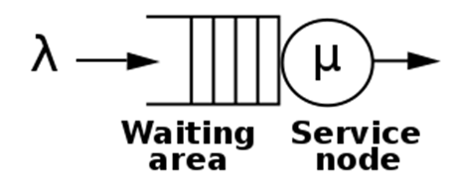
Queuing Systems
Queuing systems are everywhere.
For example, airplanes “queue up” in holding patterns, waiting for a runway so they can land. Then, they line up again to take off.
People line up for tickets, to buy groceries, etc.
The Danish engineer A. K. Erlang founded queuing theory by studying telephone switchboards in Copenhagen for the Danish Telephone Company in the early 1900s.

Slide 5
Queuing Systems (cont’d)
The interest is here to study queuing systems and related analytical methods for the study of telecommunication networks.
In telecommunication networks, queuing theory is used every time a network resource is shared by competing ‘service requests’.

Slide 6
Queues in Telecommunications
Every protocol in every node of a telecommunication network can be modeled through an appropriate queuing process.
Queues can be applied at different OSI levels:
OSI Layer 1: Blocking phenomena of a traffic flow (i.e., a call) due to unavailable resources in at least one link in the path from source to destination.
OSI Layer 2: Queuing is generated by different packets sharing the transmission resources of a link connecting two adjacent nodes (MAC, multiplexing);
OSI Layer 3: There are layer 3 buffers for IP-level QoS support (e.g., DiffServ).

Slide 7
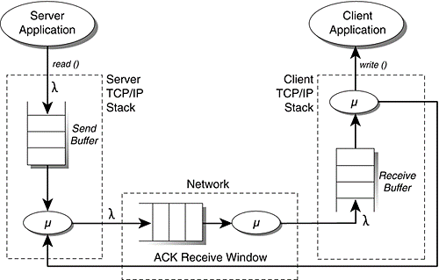
Cont.….
As example, let’s assume the TCP System Model below presented.
Notes:
The ‘λ’ defines the interarrival rate and the ‘μ’ defines the service time

Slide 8
Queuing Systems: Terminology
In the study of queuing systems, there are also different terms that have the same meaning.
Some interesting examples are:
Client/customer/service request/job/packet/message/call/etc.
Service/transmission/etc.
Server/transmitter/etc.
Queue/buffer/memory/etc.

Slide 9
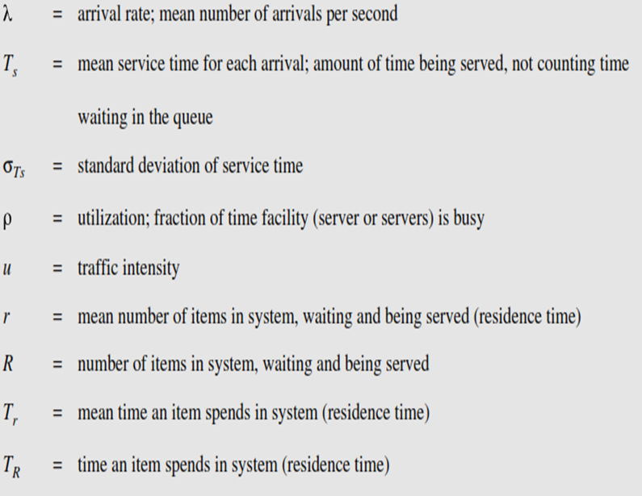
Cont.…

Slide 10
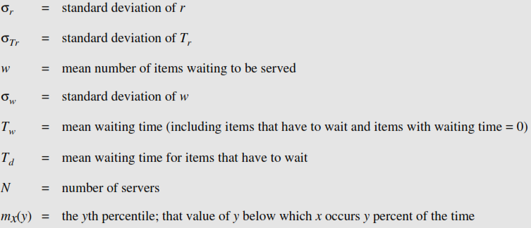
Cont.…

Slide 11
Queuing System: Basic Notations
A basic model for a delay/loss system (node or link) in telecommunications:
Mean time spent in system by a customer (service request) = T
Number of customers in the system at time t = N(t)
Fraction of arriving customers that are lost or blocked (congestion) = P_{b}
Long-term mean arrival rate of customers = λ
Average number of customers/second that pass through the system = throughput
Message,
packet,
Cell
departures
Throughput is λ
under stability
condition
Message,
packet,
cell
arrival
rate λ
+
Delay box
N(t)
P_{b}
lost or
blocked

Slide 12
Queue Analysis
Queues are special cases of stochastic processes, which are represented by a state N(t) with discrete values, for instance denoting the number of queued ‘entities’ (called below ‘requests’). Queues are modeled by ‘chains’.
A queue is characterized by:
An arrival process of service requests (mean arrival rate denoted with λ),
A waiting list of requests to be processed,
A discipline according to which requests are selected in the queue to be served,
A service process.

Slide 13
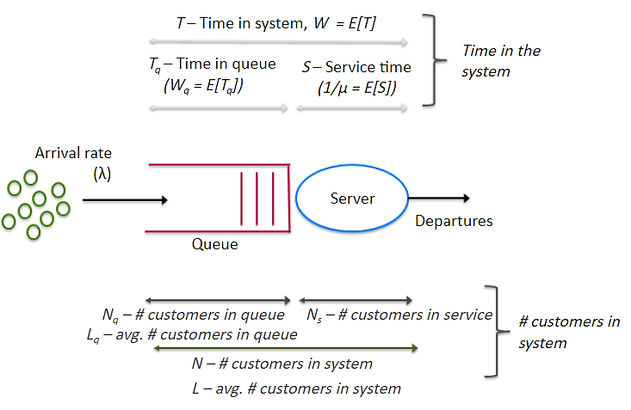
Queue Performance Parameters

Slide 14
Kendall’s Notation for Queuing Systems
A/S/m/B/K/SD
A: arrival process
S: service time distribution
m: number of servers
B: number of buffers(system capacity)‏
K: population size
SD: service discipline
D. G. Kendall, the English mathematician who first used the term ‘queuing system’ in the paper: “Some Problems in the Theory of Queues”, Journal Royal Statistical Society, 1951

Slide 15
Service Time Distribution
Time each user spends at the terminal
Distribution model
Exponential
Erlang
Hyper-exponential
General (any distributation)

Slide 16
The exponential distribution is often concerned with the amount of time until some specific event occurs. For example, the amount of time (beginning now) until an earthquake occurs has an exponential distribution. Other examples include the length of time, in minutes, of long distance business telephone calls, and the amount of time, in months, a car battery lasts. It can be shown, too, that the value of the change that you have in your pocket or purse approximately follows an exponential distribution.

Slide 17
The Erlang distribution (sometimes called the Erlang-k distribution) was developed by A.K. Erlang to find the number of phone calls which can be made simultaneously to switching station operators. Erlang was a telecommunications engineer for the Copehagen Telephone Company; his formulas for loss and waiting time were used by many telephone companies, including the British Post Office. Erlang’s distribution has since been expanded for use in queuing theory, the mathematical study of waiting in lines. It is also used in stochastic processes and in mathematical biology.

Slide 18
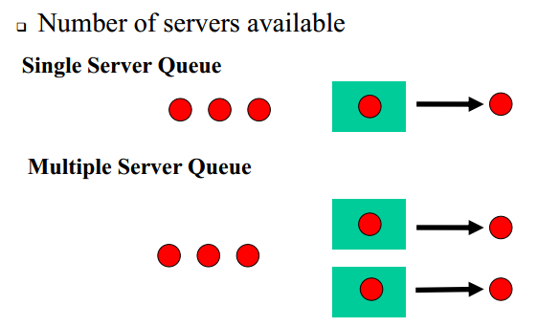
Number of Servers

Slide 19
Service Disciplines
First-come-first-served(FCFS)‏
Last-come-first-served(LCFS)‏
Shortest processing time first(SPT)‏
Shortest remaining processing time first(SRPT)‏
Shortest expected processing time first(SEPT)‏
Shortest expected remaining processing time first(SERPT)‏
Biggest-in-first-served(BIFS)‏
Loudest-voice-first-served(LVFS)‏

Slide 20
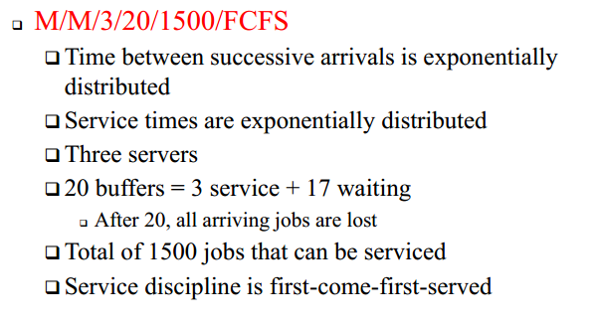
Example (Kendall’s Notation)

Slide 21
Service Policy vs. Scheduling
Service policy refers to the order according to which requests are serviced in a queue. This order can also be dynamic if newly-arriving requests can change the service order of previous ones in the queue.
Scheduling refers to the case where many queues share a given server (multiplexing context); the task of the scheduler is to select the next request to be serviced among those in the queues.
Example: Round Robin (RR) etc.
The service order can be static or dynamic.
Each queue may represent a different traffic class (in an end-host)
or different end-hosts within a class.
Overheads (e.g., headers, dead times) can be needed
in switching the server from one queue to the next one.
All queues sharing a given server
behave globally as a single queue with a suitable service
policy.
1
3
2
Head-Of-Line (HOL) packet

Slide 22
Main Performance Parameters for a Queue
The distribution of the number of requests in the queue (queue state distribution probability)
Mean number of requests in the queue, N
The distribution of the time spent from the arrival of a request to the queue to the instant when the service of this request completes.
Mean time spent to cross the queue (i.e., mean queue delay), T.

Slide 23
Queue Stability (Steady-State)
A single-server queue system is stable if
arrival rate of requests < service rate of requests
For instance in an industrial production plant modeled as a global queue, stability requires that the frequency λ of the arrival of product requests be lower than the rate of product completion, μ:
ρ = λ/μ denotes the traffic intensity offered to the queue. In a single server queue, stability requires that λ < μ or ρ < 1 Erl. ρ also denotes the ‘server utilization factor’, that is the percentage of time (between 0 and 1) that the sever is busy.
In an unstable queue:
Packets accumulate in the queue without a bound (packet delays increase continuously).
Flow/admission control may be used to limit the packet arrival rate.
Prioritization of flows keeps delays bounded for the important traffic.
λ
plant
μ

Slide 24
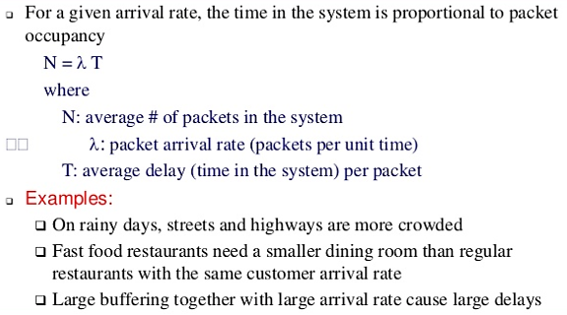
Little Formula (1961)
J. C. C. Little, "A Proof for the Queueing Formula: Λ = XW," Operations Res., Vol. 9, pp. 383-387, 1961

Slide 25
Little Formula (cont’d)
The long-term average number N of customers in a stationary system is equal to the long-term average effective arrival rate λ multiplied by the average time T that a customer spends in the system. Expressed algebraically the law is
N=Tλ .

Slide 26
Example (Little’s formula)
A monitor on a disk server showed that the average time to satisfy an I/O request was 100msecs. The I/O rate was about 100 request per second. What was the mean number of request at the disk server?
Solution:
Mean number in the disk server
= arrival rate X response time
= (100 request/sec) X (0.1 seconds)‏
= 10 requests

Slide 27
Exercise (Little’s formula)
Your computer networking professor receives 30 s per day, on average he has 15 unchecked messages, how long until he responds to your ?
A switch receives 100 packets every second, the switch can process each packet in 8ms, what’s the number of packets in system?
Notes:
L= λW
W = L/λ = 15/30 = .5 day; L = λ/W L= 100 pps x .008sec = 8 packets

Slide 28
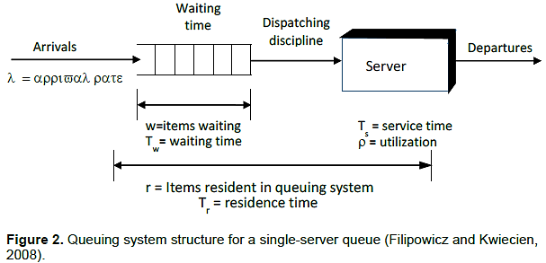
Queuing Models
The Single-Server Queue(M/M/1):first M denotes exponentially distributed inter arrival time, second M denotes exponentially distributed service times and 1 denotes single server.

Slide 29
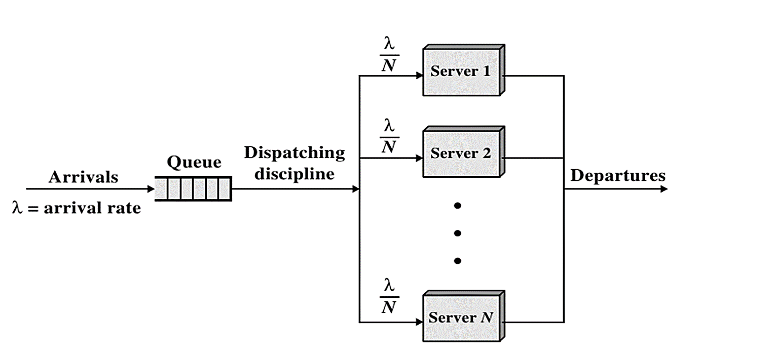
Cont.…
The Multi-Server Queue(M/M/n)

Slide 30
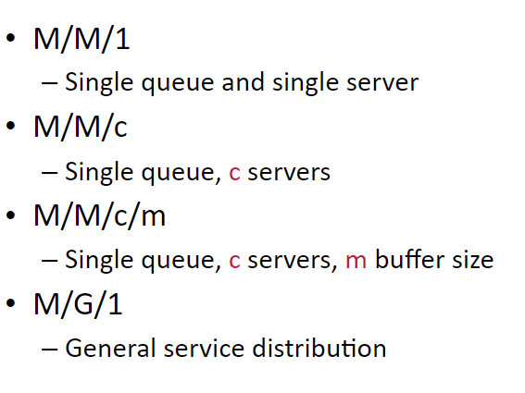
Types of queue

Slide 31
Markov Chains for Queues Analysis

Slide 32
A Markov Chain
The chain state at instant t_{n+1}, X(t_{n+1}), depends only on the state at the previous instant t_{n}, X(t_{n}).
The stochastic process evolution is characterized only by its state value at the present instant, but not on the time already spent in this state. (geometric distribution for a discrete-time chain).

Slide 33
Birth-death process
The birth–death process is a special case of continuous-time Markov process where the state transitions are of only two types: "births", which increase the state variable by one and "deaths", which decrease the state by one.
The model's name comes from a common application, the use of such models to represent the current size of a population where the transitions are literal births and deaths.
Birth–death processes have many applications in demography, queueing theory, performance engineering, epidemiology and biology.

Slide 34

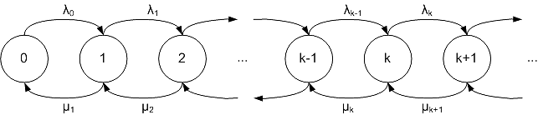
Birth-death process (cont…)
They may be used, for example to study the evolution of bacteria, the number of people with a disease within a population, or the number of customers in line at the supermarket.
When a birth occurs, the process goes from state n to n + 1. When a death occurs, the process goes from state n to state n − 1. The process is specified by birth rates

Slide 35
Birth-Death Markov Chains
A Markov chain represents a birth-death process when the state transitions in the chain occur only among adjacent states: from state i we can directly go only to state i+1 or i−1.
A Markov chain of the birth-death type can be used to model a queue with Poisson arrivals and exponential service times. These types of queues are denoted by symbols like M/M/…/… , according to the Kendall’s notation.
Queuing system
Birth-death Markov chain model

Slide 36
The M/M/1 Queue
M/M/1 queue: Poisson arrivals of requests (mean rate λ), exponentially- distributed service time (mean rate μ), single server, FCFS, infinite rooms, and infinite population of users.
The state of the system is the number of requests in the queue (including the served one).
We can model the M/M/1 queue as a special case of a birth-death Markov chain with λ_{i} ≡ λ and μ_{i} ≡ μ. Stability is assured by the ergodicity condition: ρ = λ/μ < 1 Erlang.

Slide 37
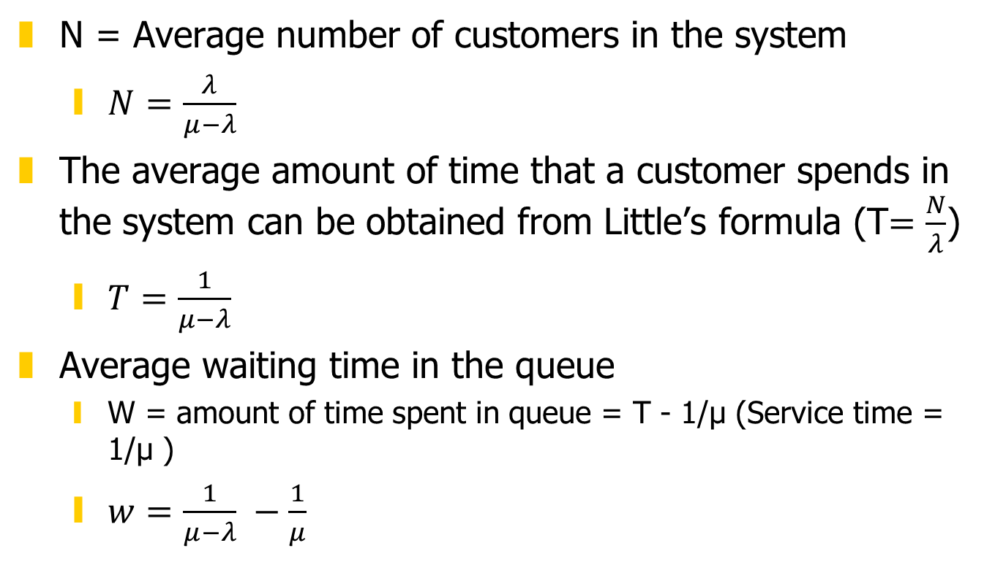
M/M/1 Operating Characteristics
N = Average number of customers in the system
$N=\frac{λ}{μ−λ}$
The average amount of time that a customer spends in the system can be obtained from Little’s formula (T$=\frac{N}{λ}$)
$T=\frac{1}{μ−λ}$
Average waiting time in the queue
W = amount of time spent in queue = T - 1/µ (Service time = 1/µ )
$w=\frac{1}{μ−λ} −\frac{1}{μ}$

Slide 38

M/M/1 Operating Characteristics (cont…)
Finally, the average number of customers in the buffer can be obtained from little’s formula
$N_{Q}=λW=\frac{λ}{μ−λ} −\frac{λ}{μ}=N−$𝜌

Slide 39




Example (fast food restaurant)
Customers arrive at a fast food restaurant at a rate of 100 per hour and take 30 seconds to be served. Using M/M/1 queuing model find the followings: m
How much time do they spend in the restaurant?
How much time waiting in line?
How many customers in the restaurant?
What is the server utilization?

Slide 40


Example (M/M/1 model)
A system is being designed. The inter-arrival times of customers are expected to be exponentially distributed with mean 1/λ = 50 msec. Three options are considered as illustrated in Figure. Find the response time in each option using queueing analysis.
Solution: This option is an M/M/1 queue with λ = 0.02 customers per msec and µ = 0.05 customers per msec. Using the M/M/1 mean response time formula, we have

Slide 41

Example (M/M/1 model)
Consider an M/M/1 queueing system. Customer interarrival times have an average of 5 minutes, and service times have an average of 4 minutes. What will be the average number of customers waiting in line?

Slide 42
Exercise
A server is designed to have the average service time of 3 minutes. How many arrival per hour can it tolerate to guarantee the average waiting time of no longer than 5 minutes? Assume the M/M/1 model.
Jobs sent to a printer are held in a buffer until they can be printed. Jobs are printed sequentially on a first-come, first-serve basis. Jobs arrive at the printer at the rate of four per minute. The average time to print a job is 10 seconds. Assuming an M/M/1 system,
Find the expected value and standard deviation of the number of jobs in this system at any time.

